Slide 1
Customer Segmentation
CAPSTONE PROJECT
Submitted by :Deepti Bhanot

Slide 2
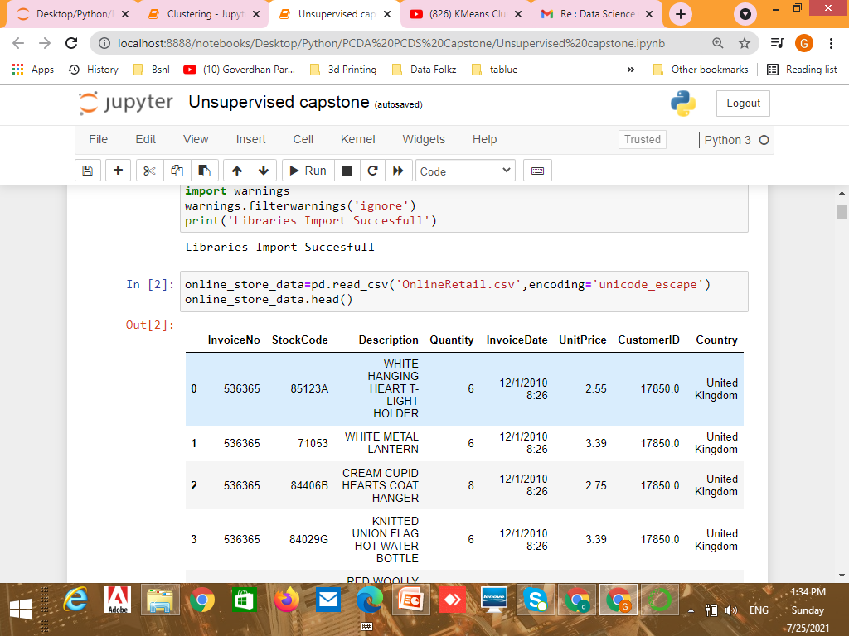
Problem Statement
The data shared by client contains a transnational data set which contains all the transactions occurring between
01/12/2010 and 09/12/2011 for a UK-based and registered non-store online retail.

Slide 3
Data Preprocessing
Chang the data type of feature Invoice No from object to date
Data set also contains 4389 duplicate records for feature country and Customer Id which was dropped.
Checking of negative values in Qty and unit price , in Quantity 8905 values are negative and no value is negative in unit price,
So we need to filter out records with negative values

Slide 4
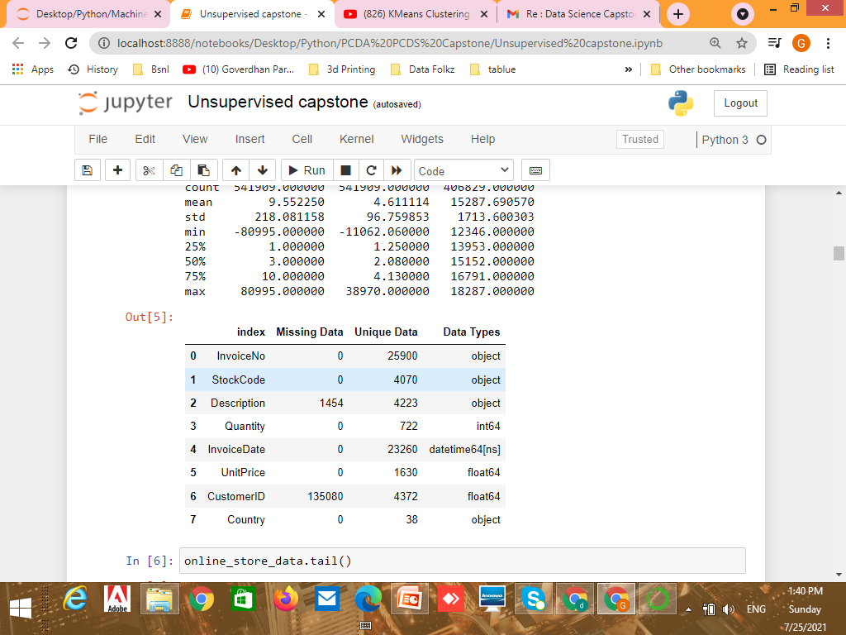
Data contains missing values in fields Description and Customer ID Which needs to be handled
Customerid =24.93% of null values Description =0.27% of null values
After completing Data Preprocessing we left with (397924, 8) where 397924 rows and 8 columns
EDA helps us to know approx 390000 record is from Unite Kingdom

Slide 5
Feature Engineering We need to perform feature engineering on given data set to get final dataset Added Features: Total amount= Quantity * Unit price

Slide 6
RFM Modeling
RFM analysis ranks each customer on the following factors:
Recency. How recent was the customer's last purchase? Customers who recently made a purchase will still have the product on their mind and are more likely to purchase or use the product again. Businesses often measure recenct in days. But, depending on the product, they may measure it in years, weeks or even hours.
Frequency. How often did this customer make a purchase in a given period? Customers who purchased once are often are more likely to purchase again. Additionally, first time customers may be good targets for follow-up advertising to convert them into more frequent customers.
Monetary. How much money did the customer spend in a given period? Customers who spend a lot of money are more likely to spend money in the future and have a high value to a business.

Slide 7
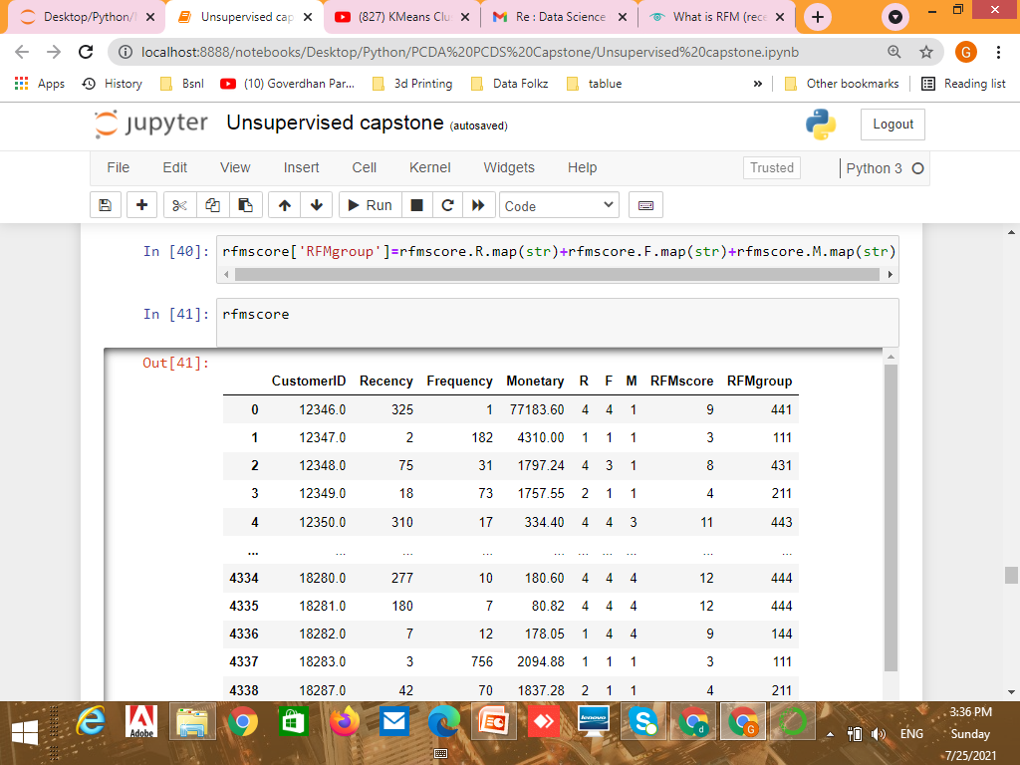
DataSet After RFM Modeling

Slide 8
Modeling
Modeling technique used is Kmeans++
Using Elbow method I found number of Optimum clusters are : 3
The Silhouette value is : 0.9379621145657494

